Slide 1
Topic: Year 8 Measurement revision EQ: What have we learnt about shapes?

Slide 2
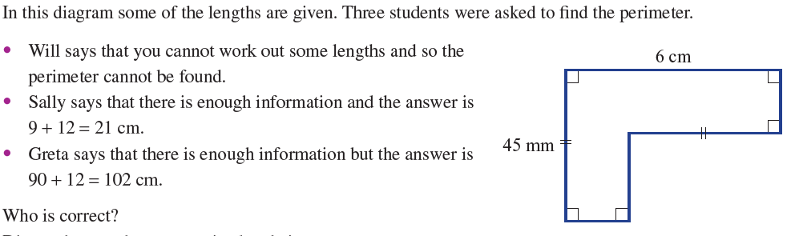

Slide 3
Perimeter: The length of a line needed to draw a shape. To find the perimeter: 1. Convert all lengths to the same units (eg mm, cm, m) 2. Find any missing sides 3. ADD all the sides together 4. Answer should be in ordinary units (mm, cm, m km) common errors are; 1. adding units of different types (eg 4cm + 5mm does not = 9) 2. Not finding missing sides

Slide 4
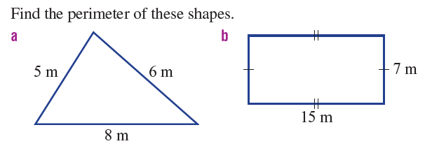
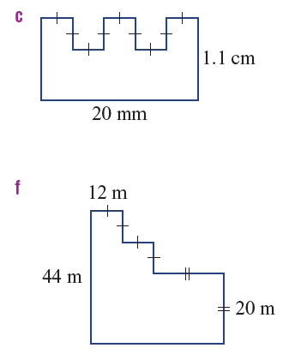
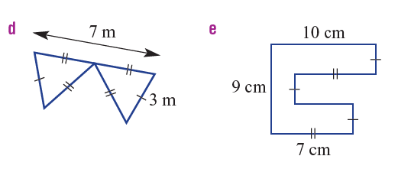

Slide 5
Area: The amount of space (number of squares) that are in a flat shape. How do we calculate it? 1. identify the shape. 2. select the right formula 3. units are the same (eg all mm or all cm 3. put the numbers into the formula and calculate 4. units are “squares” – eg mm², cm², m², km² Common errors. Using the wrong formula. Multiplying every number on the page together (not using a formula) wrong units

Slide 6
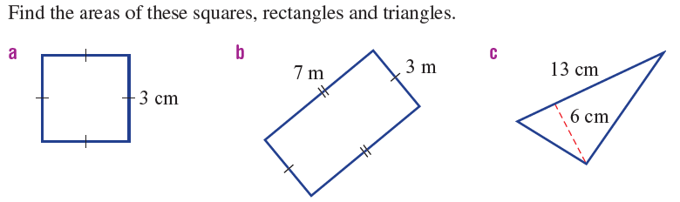
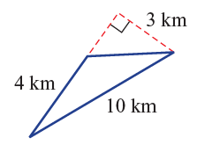
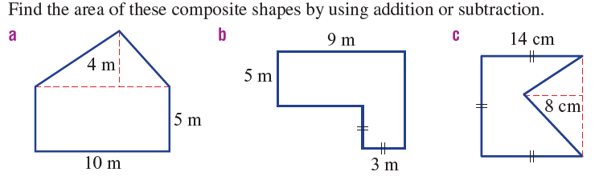
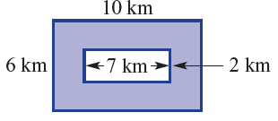

Slide 7
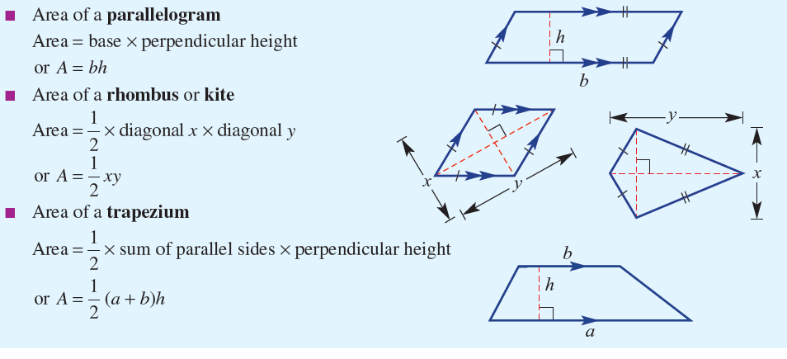
Special quadrilateral formulas

Slide 8
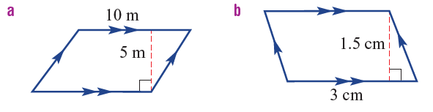
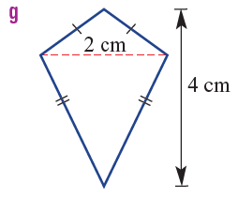
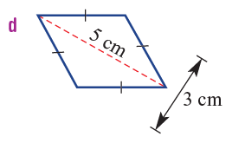
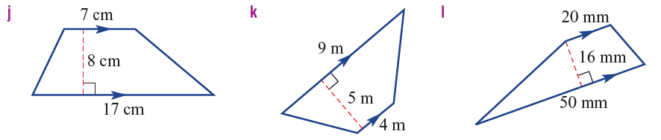

Slide 9
Volume How much (how many cubes) can fit inside a 3D shape How do we calculate it? 1. Check all units are alike (mm, cm, m or km) 2. Use area formula to calculate the area of the face 3. Multiply the area of the face by the depth 4. Units should be “cubes” (eg mm³, cm³, m³ or km³) Common mistakes 1. Just multiplying everything together 2. Wrong units or units are different types 3. Wrong formula used

Slide 10
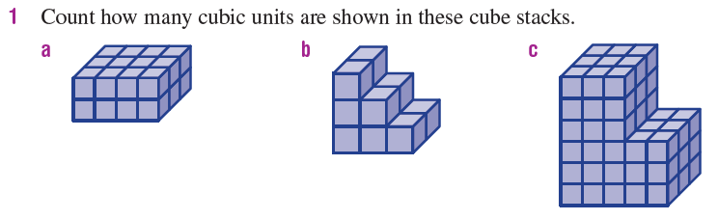
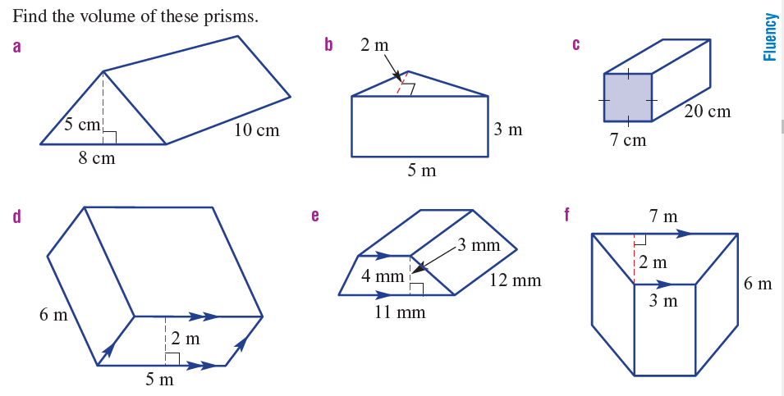
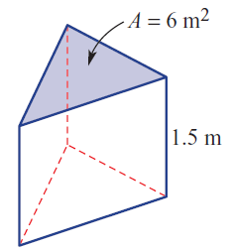

Slide 11
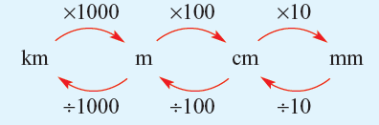
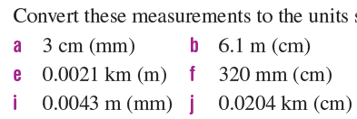
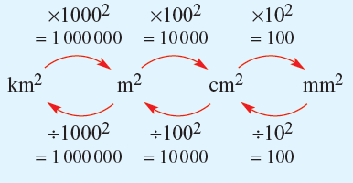
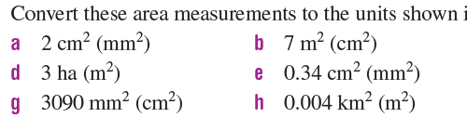
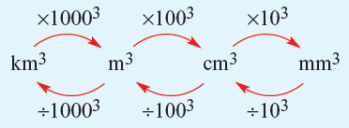
Converting units

Slide 12
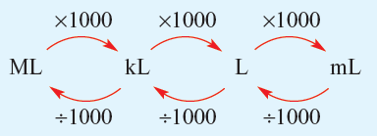
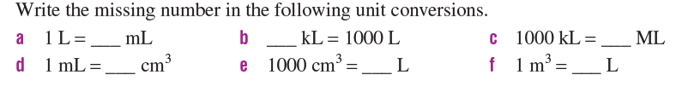
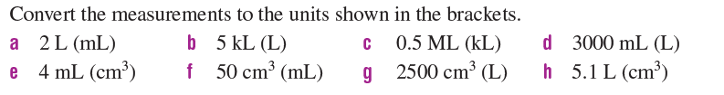
Capacity We convert our volume (mm³, cm³, m³ or km³⁾ into litres, mL etc.
1cm³ = 1mL
10000cm³ = 1l
1m³ = 1KL = 1000ml

